Slide 1
RAG with AI Search and .NET
Matt Gotteiner

Slide 2
Goal
Build an AI Chat App using the RAG approach to combine an LLM with your own data

Slide 3
LLMs

Slide 4
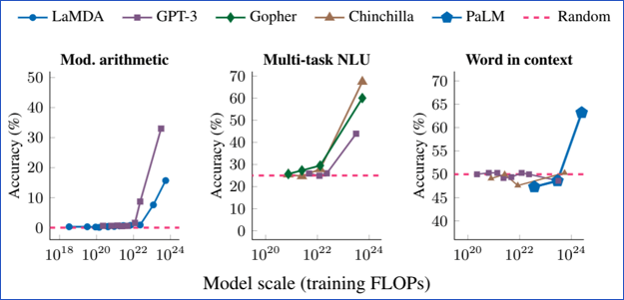
LLM: Large Language Model
An LLM is a model that is so large that it achieves general-purpose language understanding and generation​
Review: This movie is not good.
Sentiment: negative
Review: I love this movie:
Sentiment:
Input
LLM
Completion
Output
positive

Slide 5
LLMs in use today
Model | # of Parameters | Creator | Uses
GPT 3.5 | 175 B | OpenAI | ChatGPT, Copilots, APIs
GPT 4 | Undisclosed | OpenAI
PaLM | 540 B | Google | Bard
Claude 2 | 130 B | Anthropic | APIs
LlaMA | 70 B | Meta | OSS
Mistral-7B | 7 B | Mistral AI | OSS

Slide 6
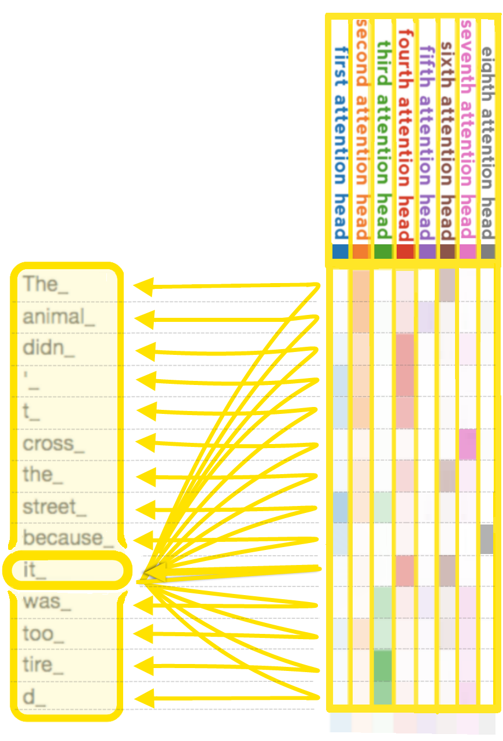
GPT: Generative Pre-trained Transformer
GPT models are LLMs based on Transformer architecture from "Attention is all you need" paper
Learn more:
Andrej Karpathy: 🎥 State of GPT
Andrej Karpathy: 🎥 Let's build GPT: from scratch, in code

Slide 7
Using OpenAI GPT Models: .NET
using Azure.AI.OpenAI;
using Azure.Identity;
using OpenAI.Chat;
AzureOpenAIClient azureClient = new(
new Uri(AZURE_OPENAI_ENDPOINT),
new DefaultAzureCredential());
// This must match the custom deployment name you chose for your model
ChatClient chatClient = azureClient.GetChatClient("gpt-4o");
ChatCompletion completion = chatClient.CompleteChat(
[
new SystemChatMessage("You are a helpful assistant that talks like a pirate."),
new UserChatMessage("Does Azure OpenAI support customer managed keys?")
]);
Console.WriteLine($"{completion.Role}: {completion.Content[0].Text}");

Slide 8
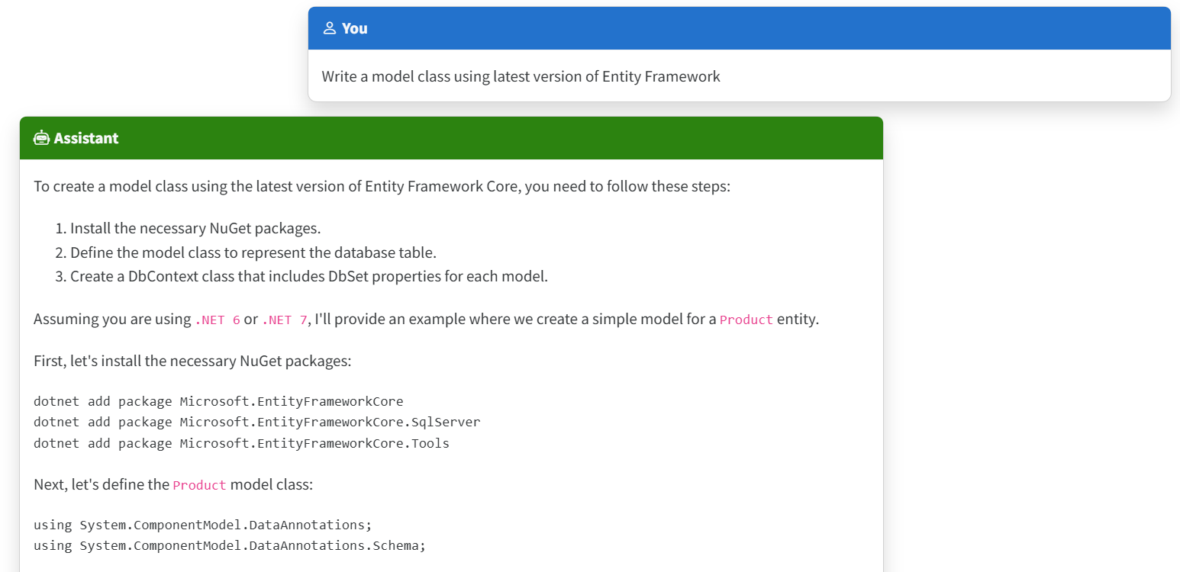
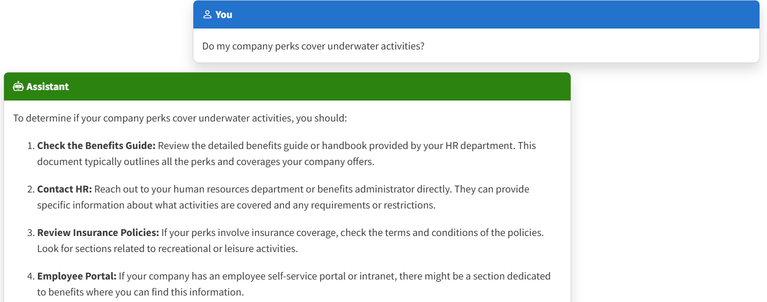
The limitations of LLMs
Outdated public knowledge
No internal knowledge

Slide 9
Incorporating Domain Knowledge
Prompt Engineering
Fine tuning
Retrieval Augmented Generation
In-context Learning
Learn new skills (permanently)
Learn new facts (temporarily)

Slide 10
Retrieval Augmented Generation

Slide 11


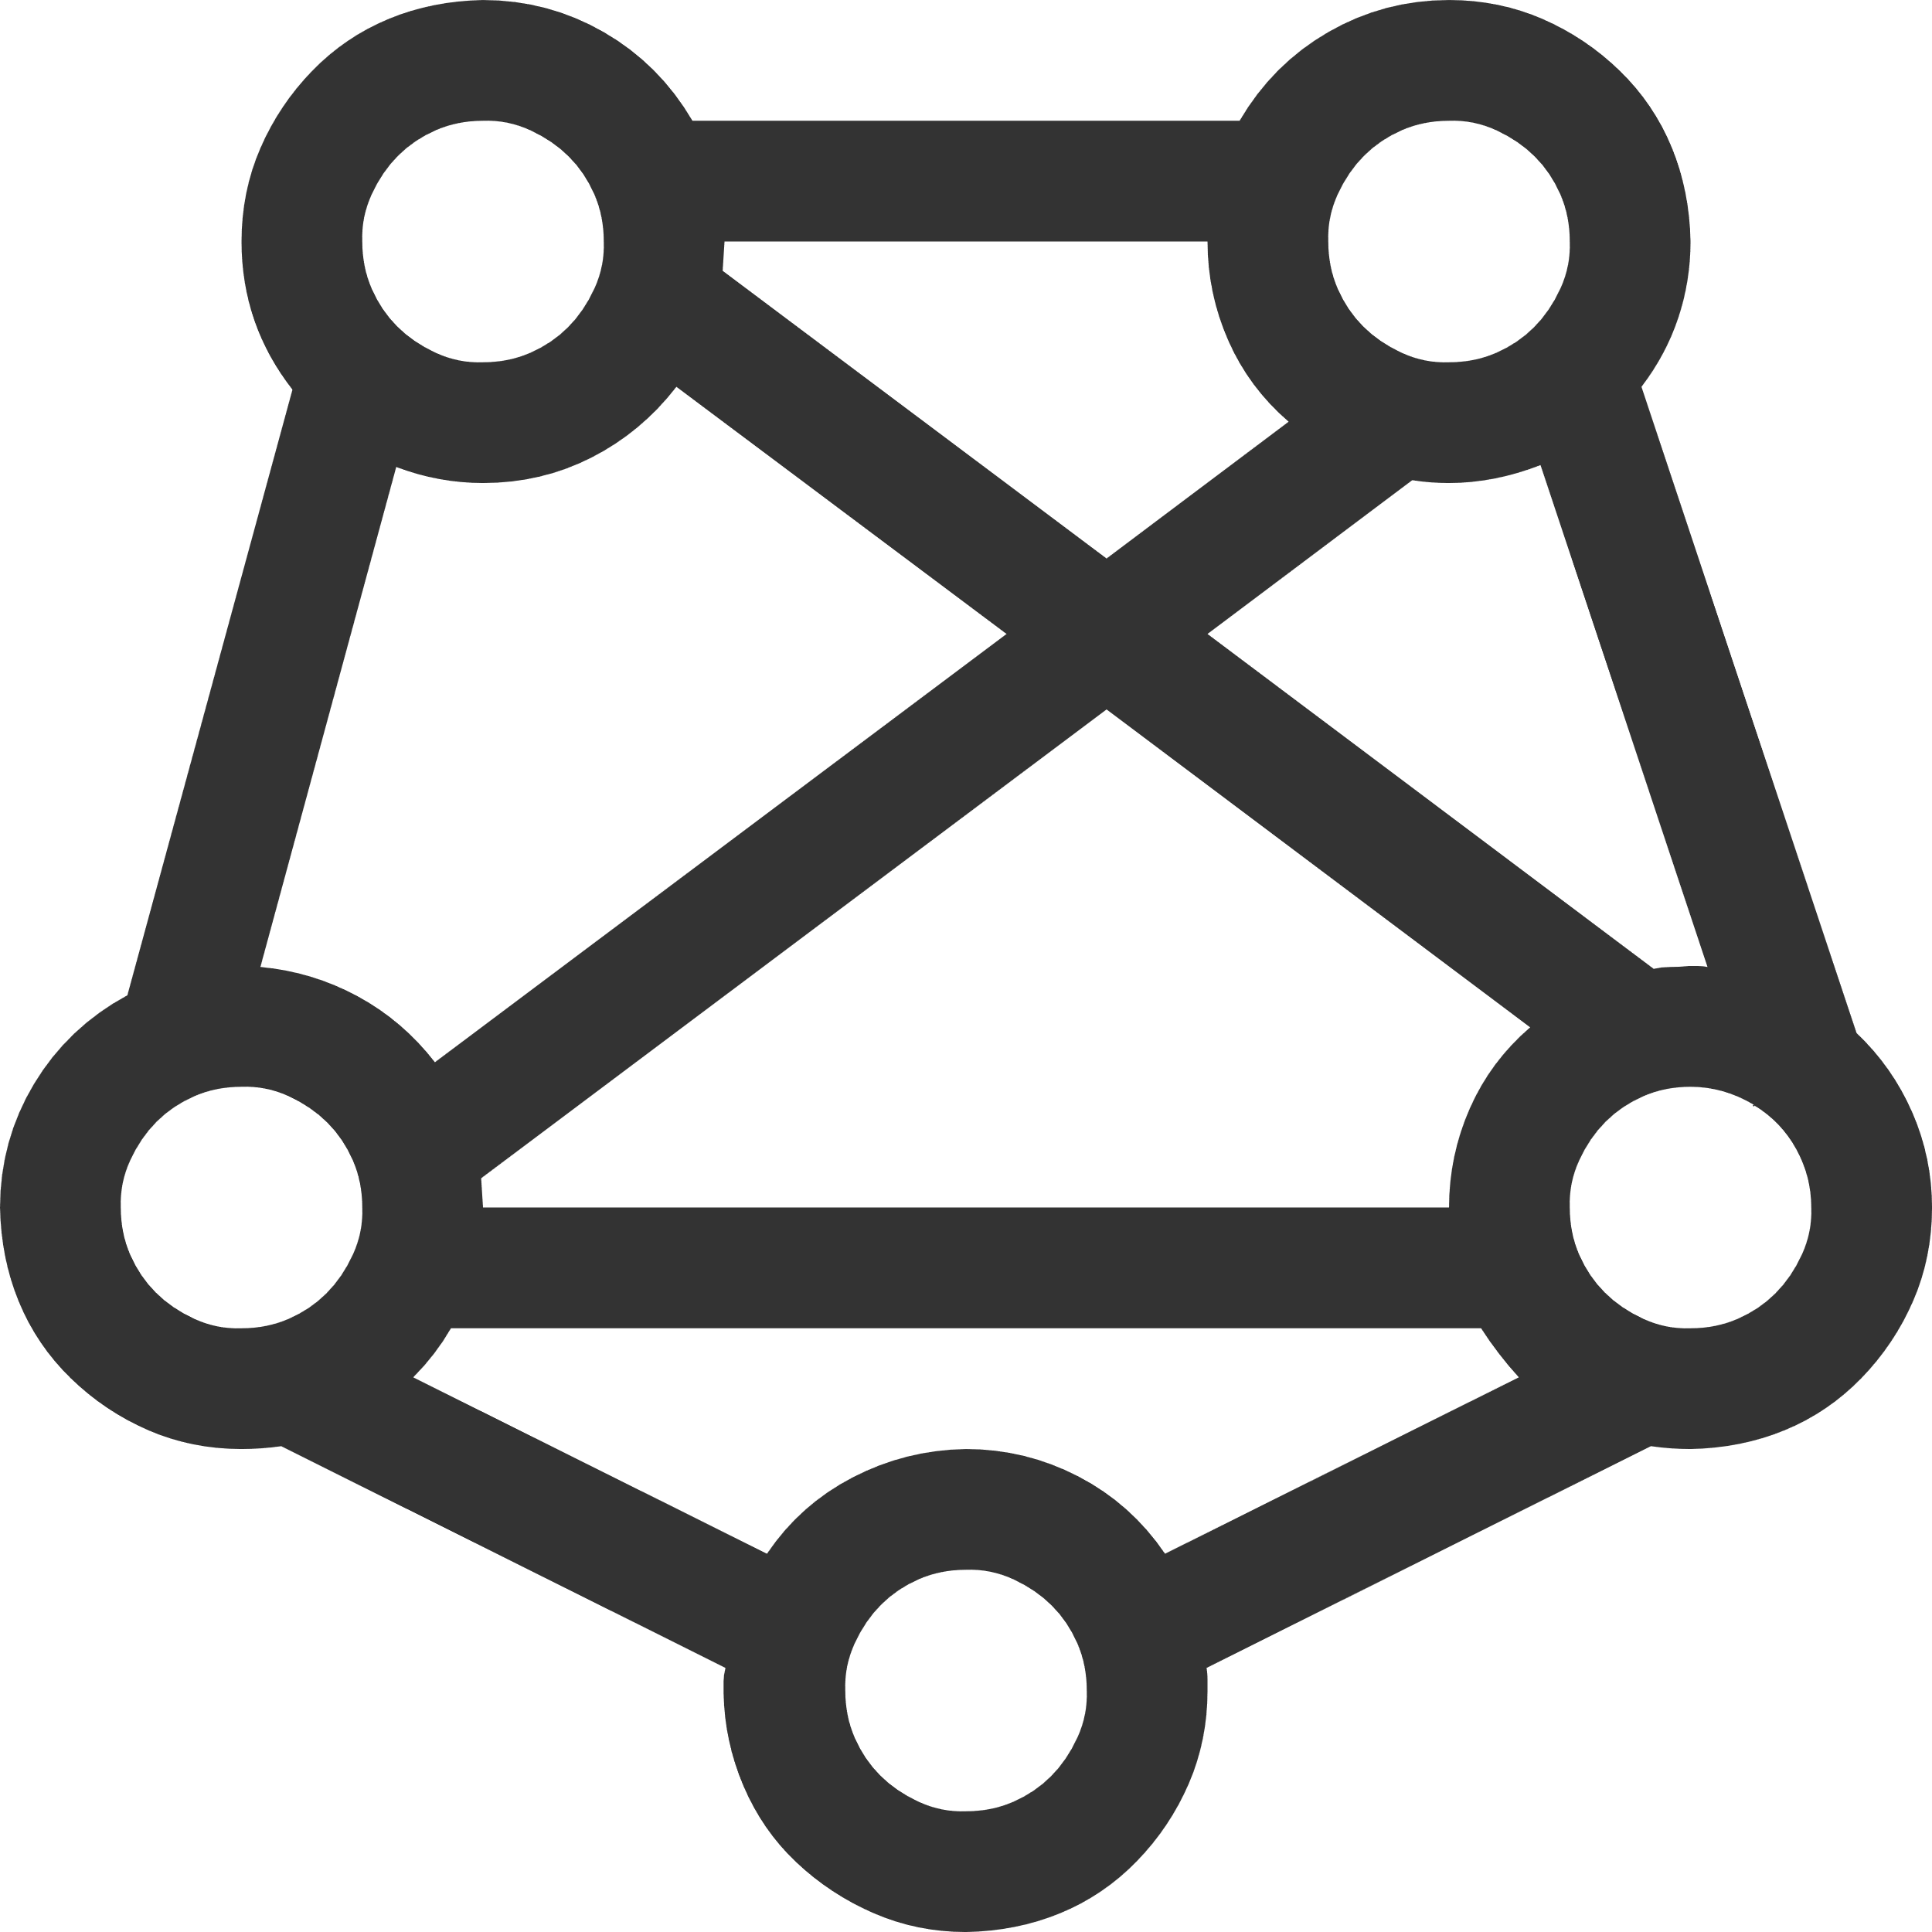

RAG: Retrieval Augmented Generation
Yes, your company perks cover underwater activities such as scuba diving lessons ¹
Do my company perks cover underwater activities?
PerksPlus.pdf#page=2: Some of the lessons covered under PerksPlus include: · Skiing and snowboarding lessons · Scuba diving lessons · Surfing lessons · Horseback riding lessons These lessons provide employees with the opportunity to try new things, challenge themselves, and improve their physical skills.….
User
Question
Search
Large Language Model
Notes:
Pamela present
In my part of the session, my goal is show you how to add user authentication to an AI app. First lets check out the base AI app.

Slide 12
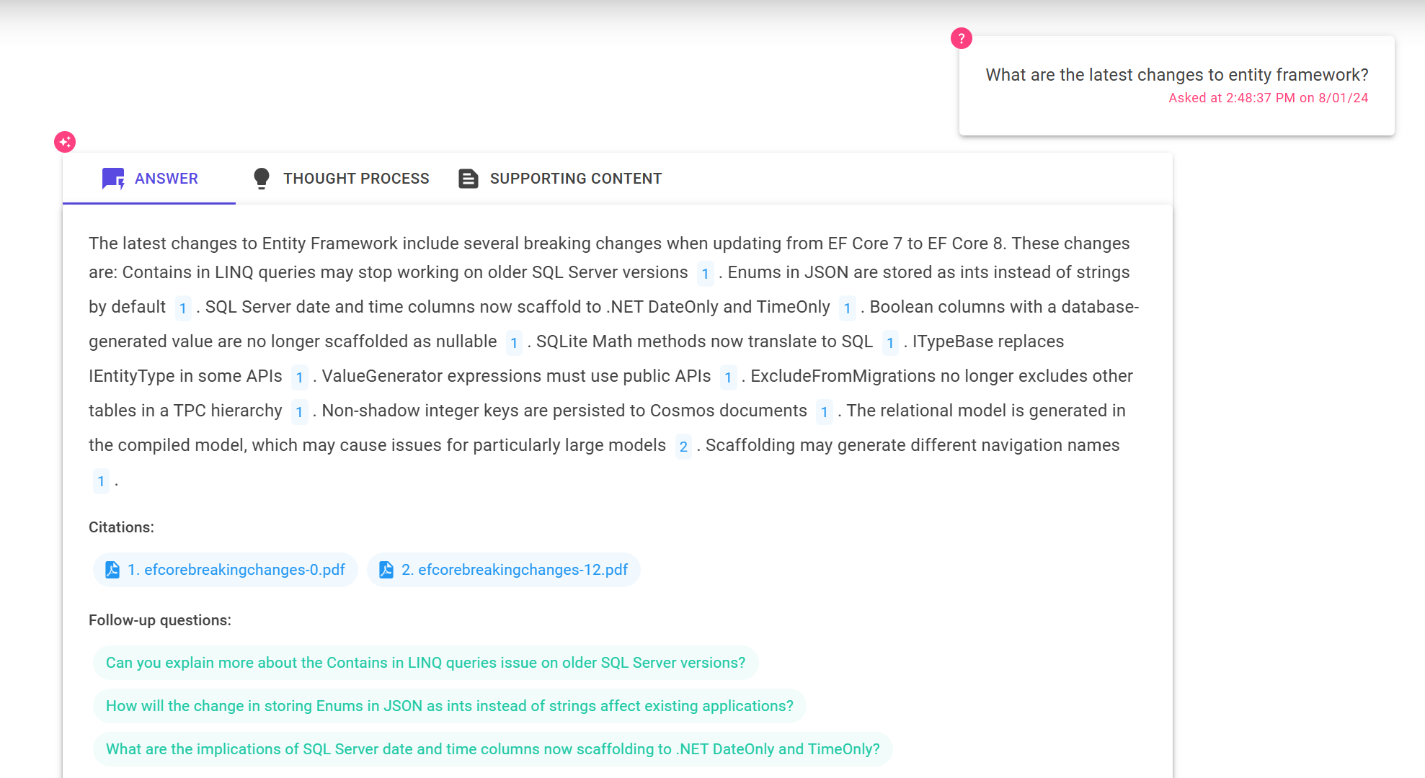
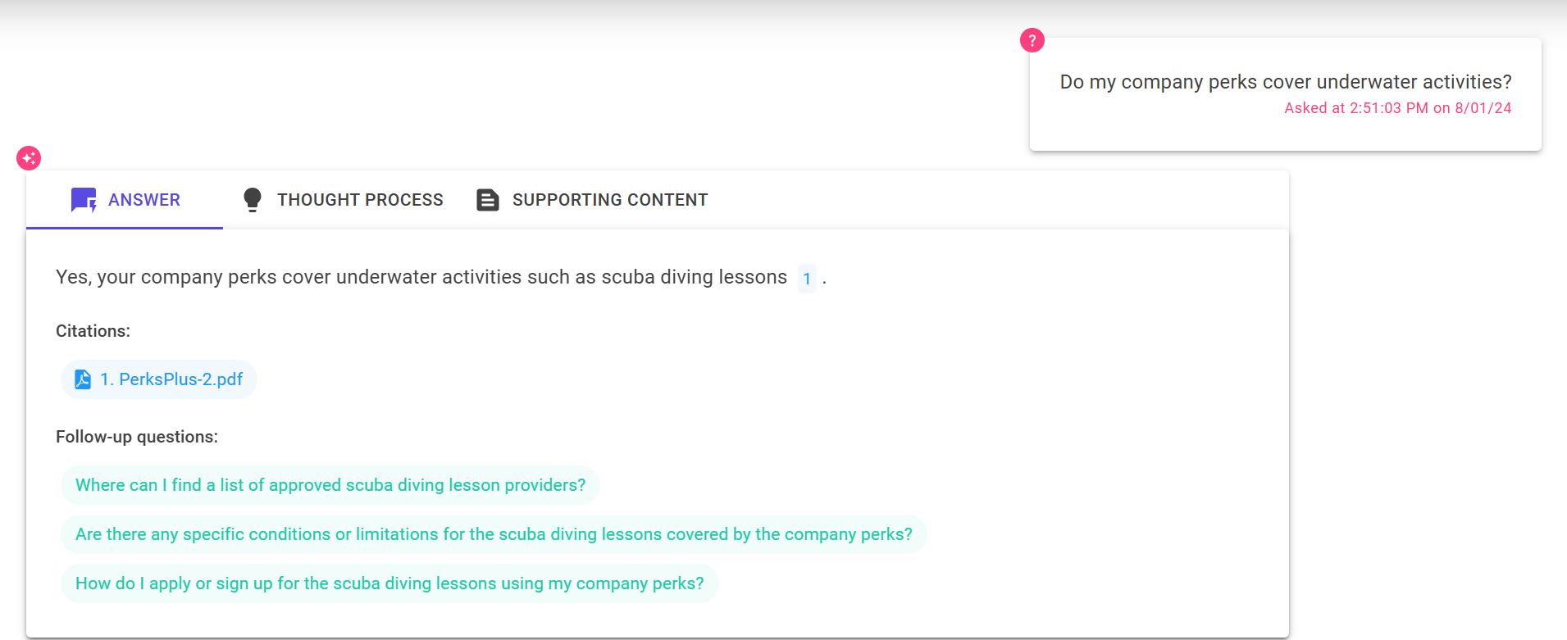
The benefit of RAG
Up-to-date public knowledge
Access to internal knowledge

Slide 13
RAG Components
Component | Examples
Retriever: A knowledge base that can efficiently retrieve sources that match a user query | Azure AI Search
LLM: A model that can answer questions based on the query based on the provided sources, and can include citations | GPT 3.5, GPT 4
Glue: A way to chain the retriever to the LLM (optional) | Langchain, Llamaindex, Semantic Kernel
Features | Chat history, Feedback buttons, Text-to-speech, User login, File upload, Access control, etc.

Slide 14
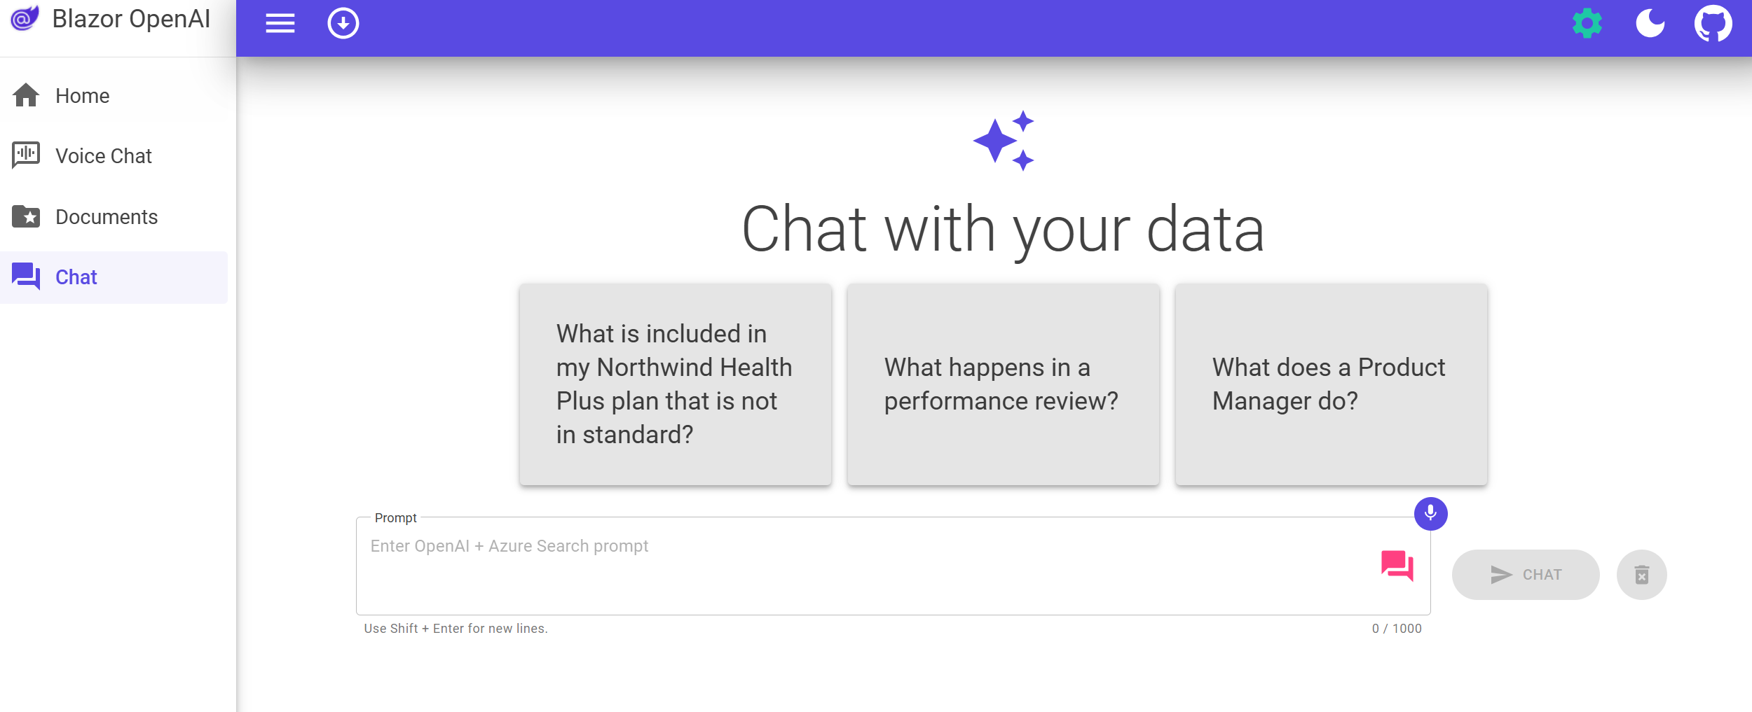
Open-source RAG chat app solution
Retriever:
Azure AI Search
LLM: GPT 3.5/4
Features:
Multi-turn chats
Voice chat
Upload your own documents
https://github.com/Azure-Samples/azure-search-openai-demo-csharp

Slide 15
Deep dive: RAG chat app solution

Slide 16
Prerequisites
Azure account and subscription
A free account can be used but will have limitations.
Access to Azure OpenAI or an openai.com account
Azure account permissions:
Microsoft.Authorization/roleAssignments/write
Microsoft.Resources/deployments/write on subscription level
https://github.com/Azure-Samples/azure-search-openai-demo-csharp?tab=readme-ov-file#account-requirements

Slide 17
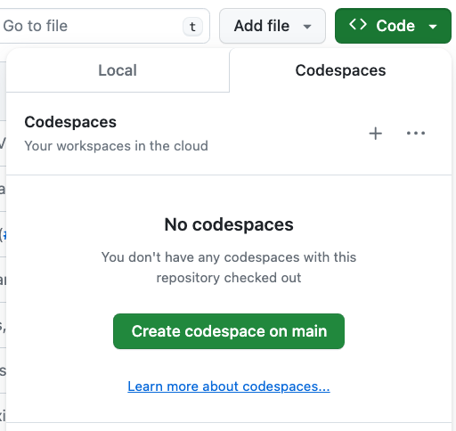
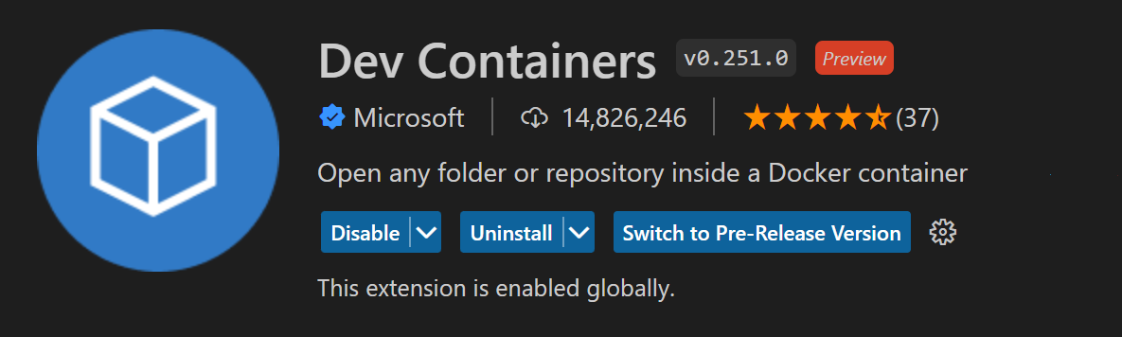
Opening the project: 3 Options
Github Codespaces
VS Code with Dev Containers extension
Your Local Environment
https://github.com/Azure-Samples/azure-search-openai-demo-csharp?tab=readme-ov-file#local-environment

Slide 18
Deploying with the Azure Developer CLI
Login to your Azure account:
azd auth login --use-device-code
Create a new azd environment: (to track deployment parameters)
azd env new
Provision resources and deploy app:
azd up
azd up is a combination of azd provision and azd deploy

Slide 19
Demo

Slide 20




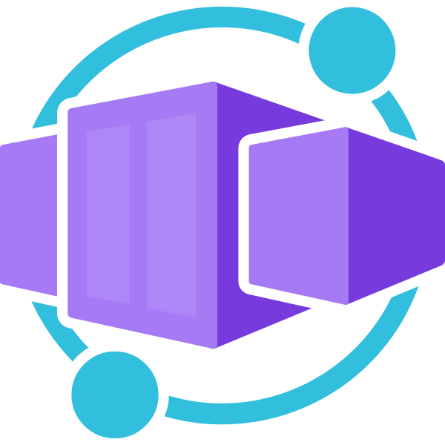

Application architecture on Azure
Blob Trigger
Store user uploaded documents
Upload documents
App UX
Perform RAG using embedding and search
Container App

Slide 21
Code Walkthrough

Slide 22
Search Approach
For optimal retrieval, search() uses hybrid retrieval (text + vectors) plus the semantic ranker option.
Reranking
Fusion (RRF)
https://aka.ms/ragrelevance
Vector
Keywords

Slide 23
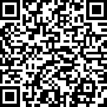
.NET Conf: Focus on AI
Learn more
aka.ms/dotnetFocusAI/Collection

